Slide 1

Tentative Title: Integrative Trajectory Forecasting for Autonomous Vehicles in Mixed Traffic Environments
Supervised By:
Md Rakibul Haque
Lecturer,
Dept. of Computer Science & Engineering, RUET.
Presented By:
Md. Nazmul Hossain Roll : 1803170

Slide 2
Topic Outline
Introduction
Literature Review
Challenges
Objectives
Methodology
Dataset Description
Conclusion
Future Work
References

Slide 3
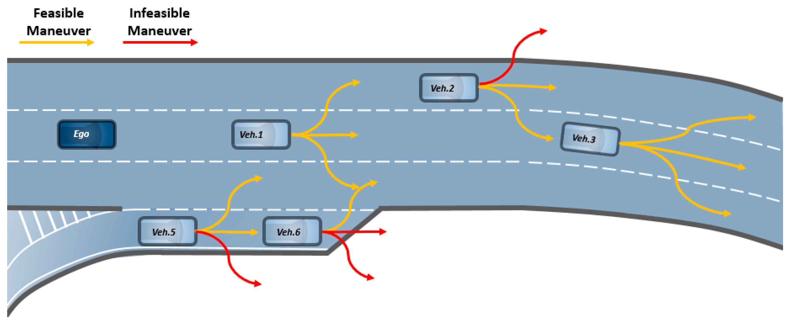
Introduction
The trajectory of a vehicle refers to the path that the vehicle follows as it moves through space over time.
For of an autonomous vehicle, trajectory becomes a complex concept that includes not just the route the vehicle takes but also the dynamics of the vehicle's motion—its speed, acceleration, and direction at every point along the route
Mixed traffic environments refer to road settings where different types of road users, such as pedestrians, bicycles, motorcycles, cars, and buses, share the same space and interact with each other.
Fig – 1: All possible trajectories of various vehicle [1]

Slide 4
Literature Review
TrafficPredict: Trajectory Prediction for Heterogeneous Traffic-Agents [2]
Performances:
TrafficPredict outperforms previous state-of-the-art approaches in accuracy for trajectory prediction in heterogeneous traffic, offering real-time performance without assumptions about traffic conditions or the number of agents.
The algorithm has been evaluated using urban dense traffic datasets and has demonstrated good accuracy in these scenarios.
Limitations:
The accuracy of TrafficPredict varies with traffic conditions and the historical duration of trajectory data available.
Future improvements will consider additional constraints such as lane directions, traffic signals, and rules, and the algorithm's performance in denser traffic scenarios needs further evaluation.
11/25/2023
Integrative Trajectory Forecasting for Autonomous Vehicles in Mixed Traffic Environments
4

Slide 5
Literature Review (CONT’D)
Interactive Trajectory Prediction for Autonomous Driving via
Recurrent Meta Program Induction Network [3]
Performances :
The proposed recurrent meta induction neural network significantly outperforms traditional kernel methods in predicting the trajectory of human-driven cars, achieving lower mean error rates in trajectory prediction for both longitudinal and lateral directions.
Limitations:
Future developments are needed for a more advanced generator and observer structure to further reduce prediction errors and to extend the framework to more general scenarios, such as turns at intersections and highway merging.

Slide 6
Literature Review (CONT’D)
Probabilistic Trajectory Prediction for Autonomous Vehicles with Attentive Recurrent Neural Process [4]
Performances :
The Attentive Recurrent Neural Process (ARNP) proposed in the paper effectively captures sequential information and the global underlying properties of traffic scenarios.
ARNP outperforms several previous approaches in terms of prediction accuracy, variance, and probability expressiveness by predicting an explicit distribution.
Limitations:
Future developments are needed for better recognize and adapt to poorly understood traffic scenarios using exploiting the application of meta few-shot learning using the ARNP model.

Slide 7
Challenges
Reduce Prediction Error
Work with Mixed Traffic Agents

Slide 8
Objectives
Deals with mixed traffic environment consists of various cars, bicycles, bikes, buses, pedestrians, traffic lights etc.
Also increasing the accuracy of the model is an obligatory part of my work.

Slide 9
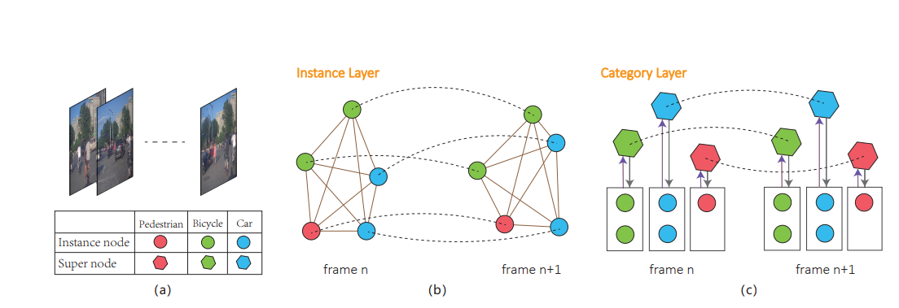
Methodology

Slide 10
Dataset Description
Attribute | Description
Frame_id | It indicates a unique frame of a video stream which is captured on 2fps rate.
Object_id | It indicates the unique object.
Object_type | It indicates the type of an object such as vehicle, bicycle, pedestrian or other.
Position_x,y,z | The position x,y,z indicates the location of an object in world coordinate system.
Object_length | It indicates the length of an object.
Object_width | It indicates the width of an object.
Object_height | It indicates the height of an object.
Heading | The heading value is the steering radian with respect to the direction of the object.
[5]

Slide 11
Conclusion
Done the Literature Review
Collected the Dataset from ApolloScape Auto Authority
Understood the all training and testing data file

Slide 12
Future Work
Apply LSTM Architecture to Train with the Dataset
Evaluate Model and Calculate Prediction Error
Reduce Prediction Error

Slide 13
References
[1] https://pub.mdpi-res.com/sensors/sensors-20-04703/article_deploy/html/images/sensors-20-04703-g001.png?1597919705
[2] Yuexin Ma, Xinge Zhu, Sibo Zhang, Ruigang Yang, Wenping Wang, Dinesh Manocha4
[3] Chiyu Dong, Yilun Chen and John M. Dolan
[4] Jiacheng Zhu, Shenghao Qin, Wenshuo Wang, Member, IEEE, and Ding Zhao
[5] https://apolloscape.auto/trajectory.html

Slide 14
Thank You

